Slide 1
ORCA: Automated Brain Tumor Segmentation Using Deep Learning
Group-8
DSAI Lab
Siddhant Bapna 23F2004494
Saurabh Yadav 23F1003171
Hardik 23F1002590
Ravineel Singhi 21F1003185
Ajsal 21F3002985
3D Attention U-Net with MRI-based Semantic Segmentation

Slide 2
Problem Statement
Current Clinical Challenges:
Manual segmentation of brain tumors from mpMRI scans is extremely time-consuming
Process takes hours per patient for expert radiologists
Significant inter-observer variability leads to inconsistencies
Impacts diagnosis, surgical planning, and treatment monitoring

Slide 3
Problem Statement
Our Solution:
Automated deep learning system for precise brain tumor segmentation
Takes multi-modal MRI scans as input
Outputs multi-class segmentation masks
Provides quantitative, objective, and reproducible tumor assessment

Slide 4
Project Objectives
Primary Objective:
Design, build, and train a deep learning model for automated brain tumor segmentation
Segment tumors into three sub-regions: Enhancing Tumor, Tumor Core, Edema
Secondary Objectives:
Achieve human-expert comparable accuracy (DSC, IoU metrics)
Develop multi-modal system processing T1, T1ce, T2, FLAIR MRI
Generate quantitative outputs (volume, composition percentages)

Slide 5
Literature Review & Existing Work
Academic Baselines:
DeepMedic: 3D CNN with multi-scale processing
U-Net: De-facto standard for biomedical segmentation
3D U-Net/V-Net: Processes entire 3D volumes
Attention U-Net: Incorporates attention mechanisms
Transformer-based Models: Swin-Unet for long-range dependencies

Slide 6
Literature Review & Existing Work
Commercial Solutions:
Brainlab: Surgical planning integration (<1 minute processing)
Quibim: FDA-cleared volumetry & longitudinal reporting
Brainomix: Validated biomarker extraction
icometrix: Longitudinal monitoring and volumetry
Siemens Healthineers: Enterprise imaging suite integration

Slide 7
Literature Review - Gaps & Opportunities
Identified Research Gaps:
Generalization Issues: Performance drops outside BraTS dataset
Multi-Modal Fusion Limitations: Simple concatenation not optimal
Sub-Region Delineation Challenges: Small/irregular boundaries difficult
Explainability Limitations: Black-box predictions in CNN models
Clinical Integration Gap: Manual quantitative data extraction needed
Limited Evaluation Metrics: Over-reliance on Dice scores

Slide 8
Literature Review - Gaps & Opportunities
Our Opportunities:
Enhanced fusion strategies with attention mechanisms
Boundary-aware loss functions for fine details
Explainability through attention maps
Automated quantitative outputs and AI reports
Comprehensive clinical evaluation metrics

Slide 9
Dataset — BraTS 2023
Dataset Specifications:
Source: BraTS Challenge 2023 (Synapse ID: syn51156910)
License: CC BY-NC 4.0 (Non-commercial use)
Patients: 1,251 with multi-modal MRI scans
Modalities: T1, T1ce, T2, FLAIR + segmentation masks
Annotations: Expert manual segmentations
Tumor Regions: Enhancing Tumor, Tumor Core, Whole Tumor

Slide 10
Dataset — BraTS 2023
Key Features:
Multi-institutional data from 70+ centers
Consistent dimensions: 240×240×155 voxels
Uniform voxel spacing: (1.0, 1.0, 1.0) mm
De-identified for research compliance

Slide 11
Preprocessing Pipeline
MONAI-based Processing Steps:
Load Images: Load 4 MRI modalities + segmentation mask
Label Conversion: Convert to multi-channel mask (WT, TC, ET)
Resampling: Uniform spacing (1.0, 1.0, 1.0) mm
Intensity Normalization: Scale to [0.0, 1.0] range
Foreground Cropping: Remove empty background
Resizing: Fixed dimensions (128, 128, 128)
Data Type Conversion: float16 for efficiency

Slide 12
Preprocessing Pipeline
Multi-Modal Fusion:
Early fusion strategy
4 modalities stacked as channels: (4, 128, 128, 128)
Single tensor input to model
Output: (4,128,128,128) image + (3,128,128,128) mask.

Slide 13
Tumor-Focused 3D Patch Extraction
Extracted 3D patches of size 64 × 64 × 64 centered around tumor regions.
Only patches with ≥ 1 % tumor voxels kept → reduces class imbalance.
Verified patches using 3D visualizations and statistical analysis
Compared full volume vs patches → patches focus on important tumor zones.
Output dataset used for training lighter 3D U-Net and V-Net models

Slide 14
Model Architecture
Overview of 3D Attention U-Net:
4 input channels → 3 output masks.
Channels: (16,32,64,128,256).
Skip connections + Attention Gates.
Encoder-Decoder
Attention Gates
Input/Output Channels
The 3D Attention U-Net utilizes an encoder-decoder architecture that efficiently captures features at various scales, enhancing the model's ability to segment brain tumors accurately.
Attention gates are incorporated to emphasize relevant features while suppressing noise, allowing the model to focus on critical areas of the MRI scans for better segmentation results.
The architecture comprises multiple input and output channels, facilitating the integration of various MRI modalities, which enhances the model's performance in identifying different tumor characteristics.

Slide 15
Model Architecture- Layer Details
Encoder Path (Downsampling):
Conv1: 4→16 channels, stride 2
Conv2: 16→32 channels, stride 2
Conv3: 32→64 channels, stride 2
Conv4: 64→128 channels, stride 2
Bottleneck: 128→256 channels
Decoder Path (Upsampling):
Up-sample1: 256→128 + Attention Gate 128
Up-sample2: 128→64 + Attention Gate 64
Up-sample3: 64→32 + Attention Gate 32
Up-sample4: 32→16 + Attention Gate 16
Output: 16→3 channels (1×1×1 conv)

Slide 16
Our Proposed Models (Patch-based)
Patch-level 3D Attention U-Net — lighter version for 128³ patches.
A compact version of the main 3D Attention U-Net trained on 128 × 128 × 128 tumor-focused patches.
Retains encoder–decoder design and attention gates to highlight tumor voxels inside each patch.
Smaller channel set → lower GPU memory need, faster convergence, better focus on local tumor regions.
3D V-Net (Residual Variant)
Employs residual blocks for stable gradient flow and smoother tumor boundaries.
Excels at learning 3D context and volumetric continuity within limited patch size.
Works well for capturing intensity variations and fine details near edges.

Slide 17
Model Training
Training Configuration:
Framework: PyTorch with MONAI
Hardware: NVIDIA Tesla P100 (Kaggle)
Batch Size: 2 (memory constraints)
Epochs: 93 total with early stopping
Optimizer: AdamW (lr=1e-4, weight_decay=1e-5)
Loss Function: DiceBCELoss (0.5 Dice + 0.5 BCE)
LR Scheduler: Polynomial Decay
Regularization:
Data Augmentation: Random flip, rotation, elastic deformation
Mixed Precision: FP16 training with GradScaler
Early Stopping: Patience = 7 epochs
Gradient Clipping: max_norm=1.0

Slide 18
Training Results- Metric Evaluation
Best Performance Achieved:
Epoch 93: Mean Dice = 0.7812
Whole Tumor: 0.8725 Dice
Tumor Core: 0.8033 Dice
Enhancing Tumor: 0.6679 Dice
Training Progress:
Initial (Epoch 1): Mean Dice = 0.2400
Mid-training (Epoch 33): Mean Dice = 0.6608
Near-best (Epoch 67): Mean Dice = 0.7590
Final Best (Epoch 93): Mean Dice = 0.7812
Key Observation:
Consistent improvement across 93 epochs
Early stopping prevented overfitting
Enhancing Tumor remained most challenging

Slide 19
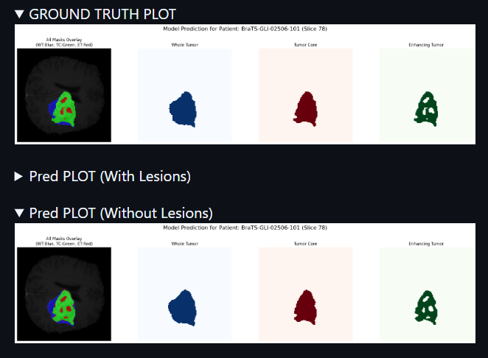
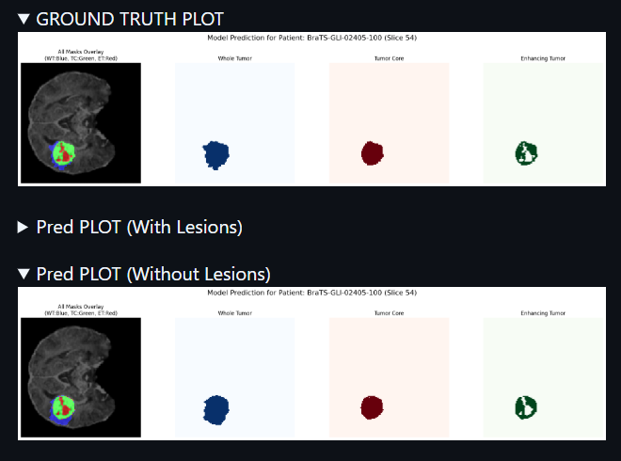
Model Predictions — Visual Results
Model correctly segments WT; ET/TC regions slightly under-segmented.

Slide 20
Hyperparameter Tuning Results
Explored Parameters:
Learning Rates: 5e-5, 1e-4, 5e-4
Batch Sizes: 1, 2
Channel Configurations: (8,16,32,64,128), (16,32,64,128,256), (32,64,128,256,512)
Loss Weights: (0.5,0.5), (0.3,0.7), (0.7,0.3)
Best Configuration:
Learning Rate: 0.0001
Batch Size: 2
Channels: (16, 32, 64, 128, 256)
Loss Weights: Dice 0.5, BCE 0.5
Gradient Clipping: 1.0
Weight Decay: 1e-5
Performance: Dice = 0.4919 (initial tuning phase)

Slide 21
Validation Results - Sample Visualizations
Sample 1: Excellent Performance
TC Dice: 0.9361 | WT Dice: 0.9195 | ET Dice: 0.8751
Clear tumor boundaries, minimal false positives
Accurate sub-region differentiation
Sample 2: Good Performance
TC Dice: 0.9486 | WT Dice: 0.9426 | ET Dice: 0.9081
Slight volume over-estimation
Well-defined enhancing tumor regions
Sample 3: Moderate Performance
TC Dice: 0.9461 | WT Dice: 0.9222 | ET Dice: 0.8509
Some boundary inaccuracies
Minor under-segmentation in edema

Slide 22
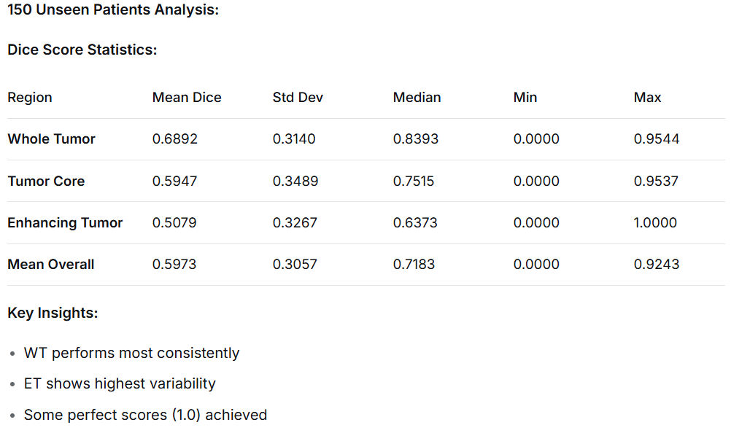
Test Set Evaluation - Quantitative Results

Slide 23
Volume Correlation Analysis
Ground Truth vs Predicted Correlation:
Tumor Core: Pearson = 0.9077 (Excellent)
Whole Tumor: Pearson = 0.8786 (Very Good)
Enhancing Tumor: Pearson = 0.8034 (Good)
Total Volume: Pearson = 0.8924 (Very Good)
Linear Regression Analysis:
Interpretation:
Consistent under-prediction (slopes < 1)
Strong size trend tracking (high R²)
ET shows weakest correlation
Region | Slope | Intercept | R²
TC | 0.9314 | -812.34 | 0.8239
WT | 0.8678 | -1883.73 | 0.7720
ET | 0.6677 | -522.34 | 0.6454

Slide 24
Error Analysis - Missed Detections
Complete Misses (Predicted Volume = 0):
Tumor Core: 12 patients (8%)
Whole Tumor: 3 patients (2%)
Enhancing Tumor: 22 patients (14.7%)
Volume Error Analysis:
Mean Relative Error: 29.64%
Median Relative Error: 16.42%
75th Percentile: 46.13%
Maximum Error: 100% (complete mismatch)
Performance Distribution:
Half of patients have <16% volume error
Quarter of patients have >46% error
Few extreme outliers with 100% error

Slide 25
Comparison with BraTS 2023 Benchmark
Performance vs State-of-the-Art:
Metric | Our Model | BraTS 2023 Avg | Top Method (nnUNet) | Gap
WT Dice | 0.8725 | 0.860 | 0.910 | +1.5%
TC Dice | 0.8033 | 0.810 | 0.867 | -0.8%
ET Dice | 0.6679 | 0.780 | 0.850 | -14.4%
Mean Dice | 0.7812 | 0.817 | 0.876 | -4.4%

Slide 26
Limitations Identified
Technical Limitations:
Computational Constraints: Limited by GPU memory (batch size = 2)
Model Capacity: Could benefit from larger architecture
Training Time: 93 epochs required for convergence
Performance Limitations:
Enhancing Tumor Challenge: Lowest and most variable Dice scores
Small Tumor Detection: Difficulty with tiny enhancing regions
Boundary Precision: Some blurring at tumor edges
Generalization: Untested on non-BraTS clinical data
Methodological Limitations:
Class Imbalance: Background dominates loss function
Post-processing: Simple thresholding may remove valid small regions

Slide 27
System Architecture & Deployment
End-to-End Web Application
Backend Architecture (Flask + Python)
Core Components:
Flask Server: RESTful API endpoints
File Handling: Secure NIfTI upload & validation
MONAI Pipeline: Identical preprocessing to training
PyTorch Inference: Trained Attention U-Net model
Post-processing: Mask refinement and analysis
Data Generation: 2D slices + 3D mesh creation
Frontend Architecture (HTML + CSS + JavaScript)
Single-Page Application Features:
Intuitive Interface: Drag-and-drop file upload
Real-time Feedback: Progress indicators
Interactive Visualization:
2D Slice Viewer with navigation
3D Volume Renderer (Three.js)
Responsive Design: Works on desktop and tablet

Slide 28
Deployment & Accessibility
Production Deployment
Containerization
Docker: Complete environment packaging
Dockerfile: Reproducible build process
Portability: Run anywhere with Docker
Cloud Deployment
Platform: Hugging Face Spaces
Access: Publicly available at [HF Spaces Link]
Scalability: Automatic resource management
Local Deployment
# One-command setup
docker-compose up
# OR
python app.py
Key Features
No GPU required for inference
Browser-based accessibility
Enterprise-ready architecture
Open-source codebase

Slide 29
Future Work & Next Steps
Try Swin-UNETR, ResU-Net.
Post-processing to remove small false positives.
Ensemble models.

Slide 30
Conclusion
3D Attention U-Net works well for brain tumor segmentation.
Dice score shows strong overlap; model generalizes well.
Patch-based method offers faster, balanced training alternative.

Slide 31
References
BraTS 2023 Challenge: https://www.med.upenn.edu/cbica/brats2023
MONAI Framework: https://monai.io
Papers: U-Net (2015), Attention U-Net (2018), V-Net (2016).
Dataset Citations: Menze et al., IEEE TMI 2015 – BRATS Benchmark.
Kaggle Implementation: https://www.kaggle.com/code/siddhantbapna/attention-btsb
Tools Used: PyTorch 1.13, NumPy, Matplotlib, MONAI Transforms.

